Slide 1
CREATIVE WAYS TO SAVE WATER

Slide 2
KITCHEN
Wash your fruits and vegetables in a pot of water.
Designate one glass or water bottle to drink water out of so you don’t have to continue washing new cups throughout the day
Compost vegetables and fruits instead of using the garbage disposal. It will power up your plants and save water.
If you accidentally drop ice, don’t throw it in the sink – put it in a house plant. If there’s any ice left over from a drink do the same thing.
Try to use fewer pots and pans when cooking, you’ll have less to wash.
Click here for yummy recipes that only require the use of one pot! Perfect for warming up during the cold season.

Slide 3
BATHROOM
Leave a tub in the shower to get the excess water while it warms up. You can use this water for your plants!
Take a shower right after someone gets out so you don’t have to wait for it to warm up.
Shorten your shower by a minute or two and you’ll save 100+ gallons a month!
While washing your hands or brushing your teeth, turn off the sink when you’re not using the water.
Plug the sink while shaving to save water when rinsing your razor
Use a tub of water to shave instead of letting the shower run
LAUNDRY
When washing clothes make sure you’re washing a large load instead of half a load
Only wash your clothes after a few uses
GARDEN/PATIO
Harvest rainwater in a few different ways to save water and have it for later use. If you’d like more information on harvesting rainwater – read up on your options here.
Use a broom instead of a hose to clean patios, sidewalks, and driveways

Slide 4
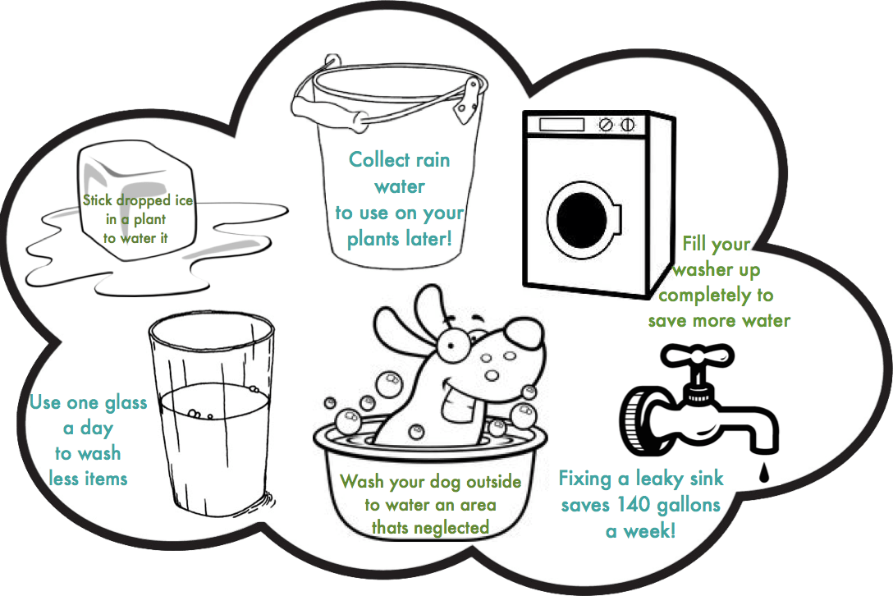
MORE FUN FACTS ABOUT CONSERVING WATER!

Slide 5
Personally, my favorite ways to save water are the little things I do around my household. I take shorter showers knowing every time I bathe I’m saving gallons of water. I also enjoy taking my dog and washing him in spots I knew I missed when watering my yard last. If you’d like to use a soap that’s good for the environment and easy to find, you can stop at your local market and pick up Dr. Bronner’s biodegradable soap. You’d be using environmentally responsible products and it’s less of a mess for you to clean up! Though I had a slightly difficult time adjusting, I ended up getting used to doing these things. Knowing I do my part to make a small difference in the world makes it so much easier to retain these habits. I encourage you to do the same because in the long run – you’re helping our world as a whole.

